Slide 1


Recursion
Demo Lesson 11/6/2024
Dr. Michael Robbeloth
Notes:
Droste effect is a visual example of what we are going to discuss today.
18th/19th century satire magazine.

Slide 2

Who Am I?
Dayton, Ohio native
Lived in Amish country past six years, Knox County, has 64k inhabitants
Worked approximately 18 years in industry/consulting (primarily embedded and distributed computing)
Almost eight years in academia
Ph.D. from Wright State (all Ohio colleges/Universities)
Married 22 years
Generation X dad with Generation Alpha daughter (6 years old)
No millennial or Gen Z kids ☺
Dachshund daddy, nine-year-old black & tan Leonie
I love Computer Science and being a geek!
Hobbies: Photography, Hiking, Slow Running, Travel, & Gaming (Just One More Turn!)
Twitter LinkedIn, & Instagram @mrobbeloth

Slide 3
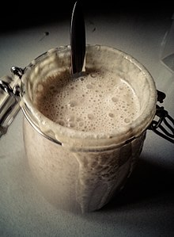
Learning Outcomes
Define recursion
Describe the principles of recursion
Analyze and evaluate recursive algorithms
Write one ourselves
If we have time:
Determine the output of code segments w/ recursion
Notes:
Making sourdough
To make sourdough you start with some sourdough from the last time
It uses itself to solve the problem of making some food

Slide 4
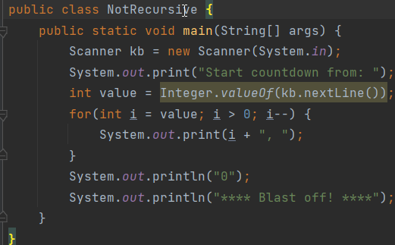
What are the three basic programming statements?
Sequential (Ex. assignment, normal procedural/method invocation)
Conditional (Make a Decision)
Iterative (Repeat sequence of instructions)
Notes:
Ask the students this question?

Slide 5
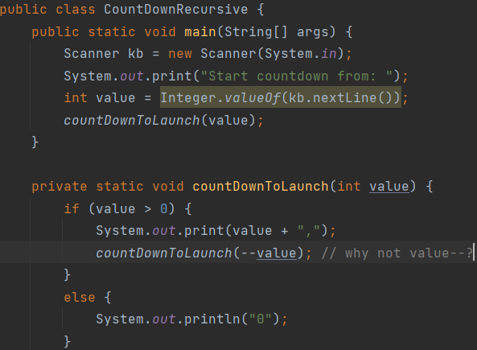
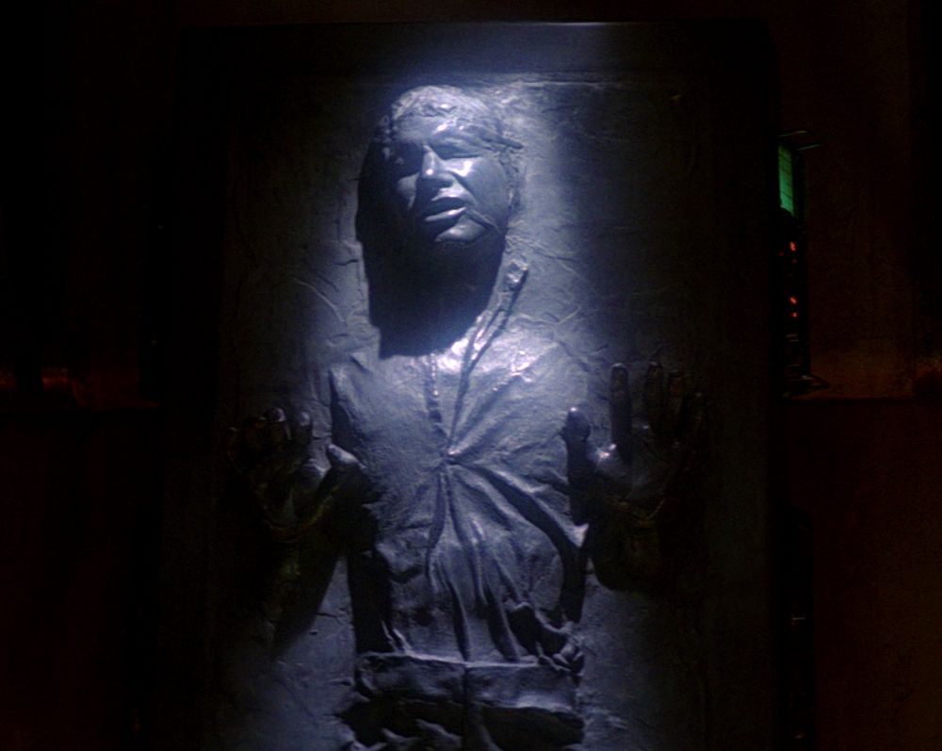
Now let’s consider a fourth type of programming statement
Can anyone define recursion for me?
What if we could have a statement that calls the procedure it is already running inside of?
That would be awesome.
Indeed, we do, it’s call recursion

Slide 6

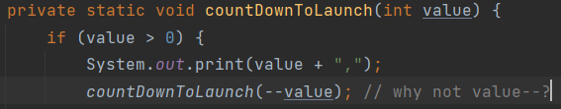
I have a question? (You should have a question at this point)
It won’t take that long ☺
Exception in thread "main" java.lang.StackOverflowError
Don’t loops have a way to stop themselves?
Yes! (some terminating exp./stmt.)
So, what happens when there isn’t some mechanism to stop the loop?
We need to make the problem smaller when we call the procedure again
Did you recall how we made the count down method simpler on each call?
Notes:
We don’t want this program to keep calling the same routine over and over again…
We need to work our way down to the base case.

Slide 7
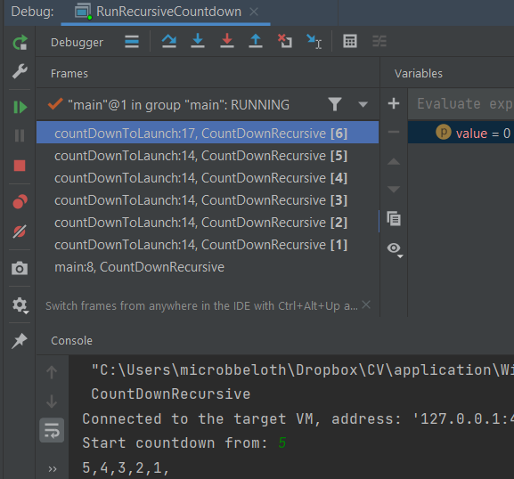
A deeper inspection on recursion

Slide 8
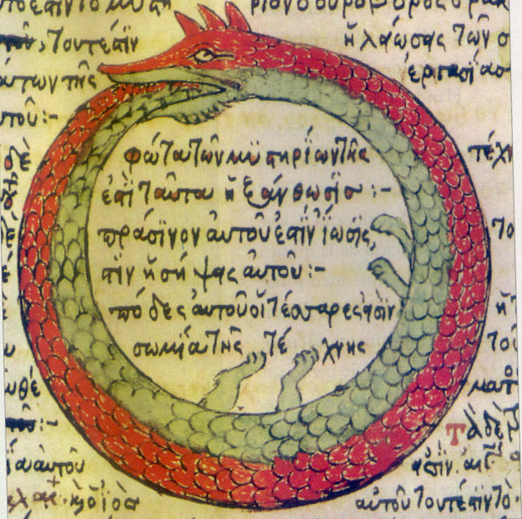
To recap…
Recursion is a computational problem-solving method whereby we have a procedure (e.g., function) that calls itself
Each time, we have a recursive, problem-reducing, step
Eventually, we reach one or more base cases (w/no recursion)
The power of recursion evidently lies in the possibility of defining an infinite set of objects by a finite statement. In the same manner, an infinite number of computations can be described by a finite recursive program, even if this program contains no explicit repetitions. Niklaus Wirth
Notes:
Ouroboros, an ancient symbol depicting a serpent or dragon eating its own tail. Ah, here we have no base case that can be reached and a biological stack overflow will result ☺
eternal cyclic renewal or a cycle of life, death, and rebirth

Slide 9
What’s the tradeoff between recursion and iteration?
Have equal expressive power
Recursion makes some problems easier to solve
Iteration makes other problems easier to solve
Recursion incurs a performance penalty w/o tail call optimization (not sure about recent versions of Java/JEPs, but not available, would need Scala/Groovy/Clojure)
Recursion needs more storage needed
Notes:
16 MB vs 580 MB for 46th Fibonacci number

Slide 10
Display Numbers As Words
Number has multiple digits
Need to write out the word for each digit
What are our subtasks here?
Display all digits but the last as words
Display last digit as a word
Which one is the base case vs reduction step?
Notes:
if (number < 10) { String digitStr = getWordFromDigit(number); System.out.print(digitStr + " "); } else { displayAsWords(number / 10); System.out.print(getWordFromDigit(number % 10) + " "); }

Slide 11
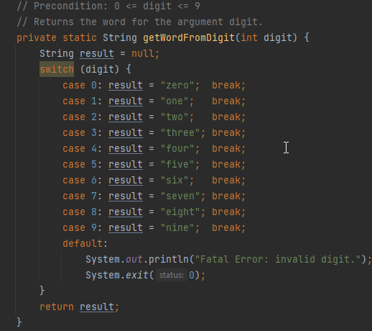
Display Numbers As Words Base Case

Slide 12
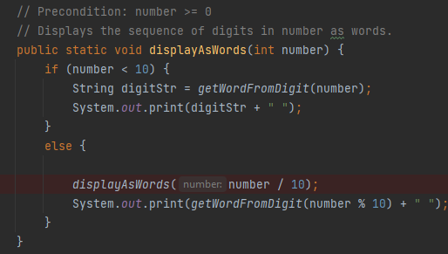
Display Numbers As Words Reduction Step
Notes:
987 98 9
Nine
Eight
Seven
What if we left out the check for number < 10. What would happen? That’s right stackoverflow.

Slide 13
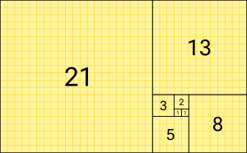
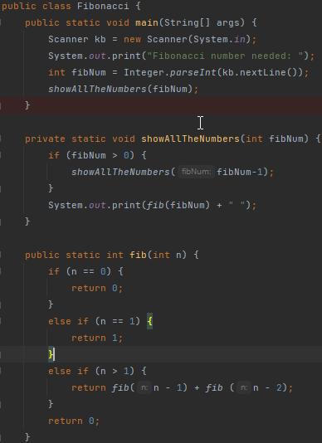
Fibonacci
Each number is the sum of the preceding two numbers
F₀ = 0
F₁ = 1
For K > 1 F_{K} = F_{K-1} + F_{K-2}
What is/are our base case(s)?
How do we use recursion to make the problem smaller? What is the reduction step?
Notes:
A tiling with squares whose side lengths are successive Fibonacci numbers: 1, 1, 2, 3, 5, 8, 13 and 21.
Core of the method definition must be if-else statement/branching statement
One/more branches should include recursive invocation of the method (make the problem smaller)
One/more branches should not include a recursive innovation (get out of the maze-like Celebration Florida ☺); base case(s), stopping case(s)

Slide 14
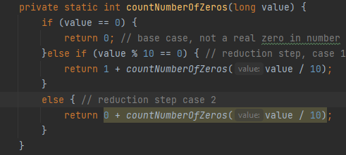
Let’s do this together -- Find number of Zeros
Count the number of zeros in the number?
What is the base case vs reduction step?
Notes:
// instead of more than one base case, more than one recursive case
private static int countNumberOfZeros(long value) { if (value == 0) { return 0; // base case, not a real zero in number }else if (value % 10 == 0) { // reduction step, case 1 return 1 + countNumberOfZeros(value / 10); } else { // reduction step case 2 return 0 + countNumberOfZeros(value / 10); } } }

Slide 15

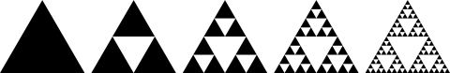
Sierpinski Triangle
Equilateral triangles subdivided recursively into equilateral triangles
Reproducible at any level of detail w/enough computational power
Start w/ equilateral triangle
Subdivide into four smaller congruent triangles using an upside-down equilateral triangle
“Remove” the central triangle
Repeat w/ smaller triangles inside
x/4 area removed first cut
(3 * 1)x/(4*4) second cut; (3 * 3)x/(16*4) third cut or 3x/16 and 9x/64
Using infinite geometric sequence add all terms
Given 1st geometric term and common ratio:
a₁ / (1 – r) = x/4 / (1 – ¾)=1 ; in general: a_{n}=1/2(3^{n}-1)
Notes:
First cut, x/4 is removed, where x is the original triangle’s area
Second cut 3x/16 is removed
A1 first term of geometric sequence and r is common ratio. Plug in those terms
Geometric series being ar = ar + ar^2 + ar^3 … → closed form (Finite # of terms) is a/(1-r) ; |r| < 1

Slide 16
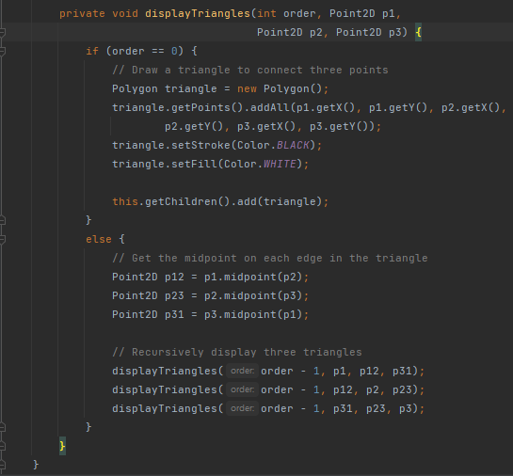
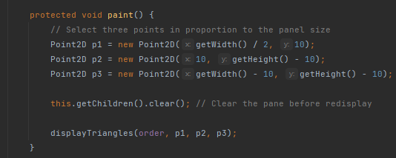
Sierpenski Triangle Code Sample
Notes:
1, 4, 13, 40, 121, 364, 1093, 3280, 9841, 29524, etc.

Slide 17
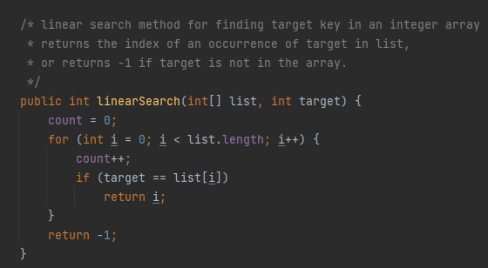
Searching
If an array is sorted, what’s a simple way to search it?
Start at the beginning and look at each element.
If not sorted, must do it this way

Slide 18
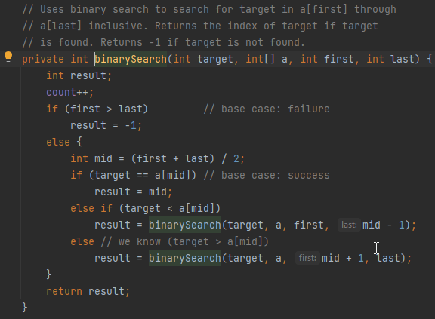
Deeper Dive Binary Search
Binary Search
Find out if a number is in a sorted array
Do it recursively, of course.
Where do we start?
Middle of the array
What do we keep track of?
Target, array, first, and last index.
What if the number isn’t there? When would this occur?
First > Last Return some negative value
What if the target is less than midpoint?
Call procedure again w/ first and last = mid – 1
What if target is greater than midpoint
Call procedure again w/ first = mid + 1 and last
Notes:
Work through onboard example
The middle of the array.

Slide 19
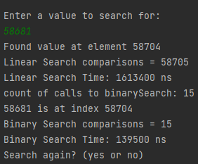
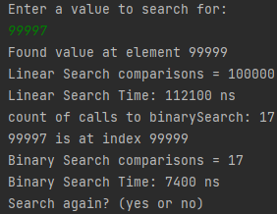
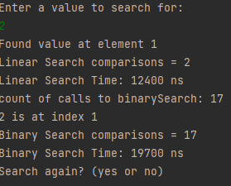
Binary Search Performance
Extremely Fast
~½ array eliminated at each call to method
1000 elements, ~10 array searches worse and average case
100,000 elements, ~17 array searches
Vs sequential w/ 1000 elements needing ~500 comparisons on average
In general, for n elements:
log₂(n) worse case
log₂(n) average case
1 comparison best case
Notes:
100,000 elements in screen grab
1.613 ms
Vs
139.5 us
For typical case
Caching taking effect on last one, would need multiple runs w/ restart of IDE and maybe system.

Slide 20

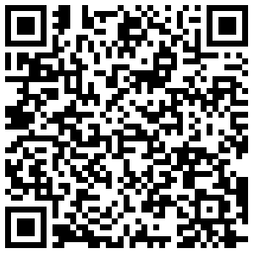
Questions
Thank You!
Presentation at QR below:

Slide 21
Overtime
2. What output will be produced by the following code?
public class Demo {
public static void main(String[] args) {
System.out.println("The output is:");
bar(11156);
System.out.println();
}
public static void bar(int number) {
if (number > 0) {
int d = number % 10;
boolean odd = (number / 10) % 2 == 1;
bar(number / 10);
if (odd)
System.out.print(d / 2 + 5);
else
System.out.print(d / 2);
}
}
}
1. What output will be produced by the following code?
public class Demo {
public static void main(String[] args) {
System.out.println("The output is:");
foo(23);
System.out.println();
}
public static void foo(int number) {
if (number > 0) {
foo(number / 2);
System.out.print(number % 2);
}
}
}
Notes:
MergeSort could be nice as well. N log n for average/worst case complexity
Split into halves, work first half, work second half, merge by sorting two elements and then returning to higher
Copy before or after on merging

